Slide 1
SonarQube binding

Slide 2
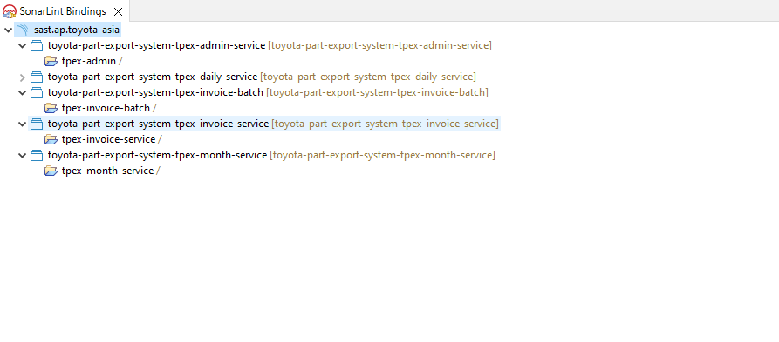
Shikha Jaiswal

Slide 3
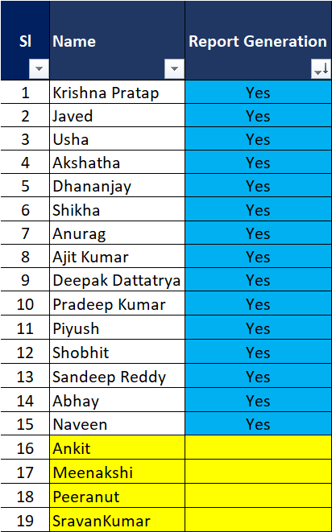
Sonar Report Generation Status – for BE Resources

Slide 4
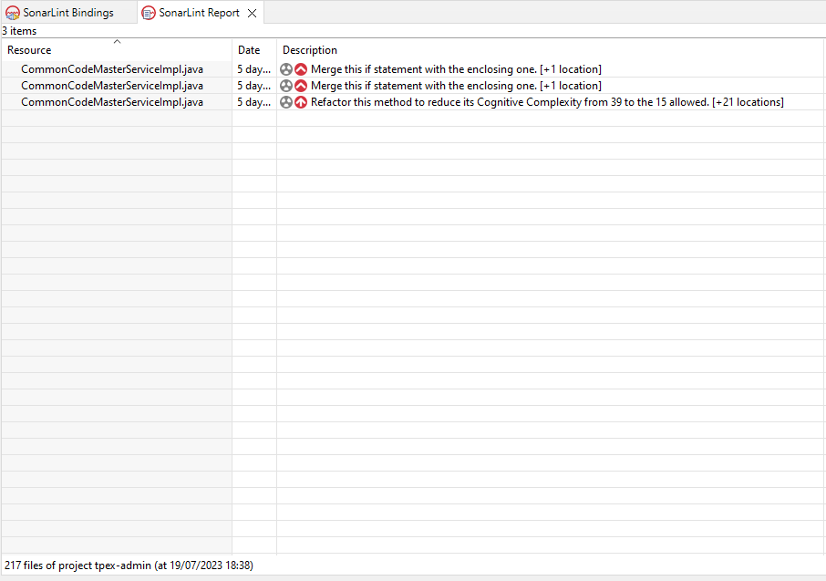
Shikha Jaiswal

Slide 5
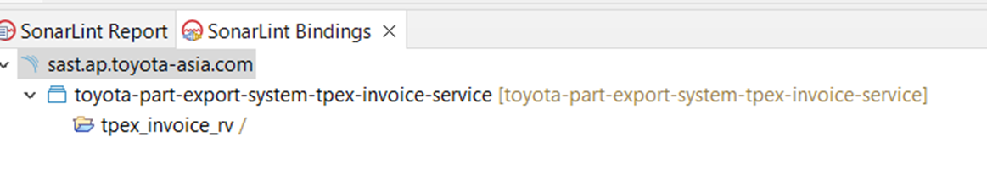
Rajeev Varshney

Slide 6
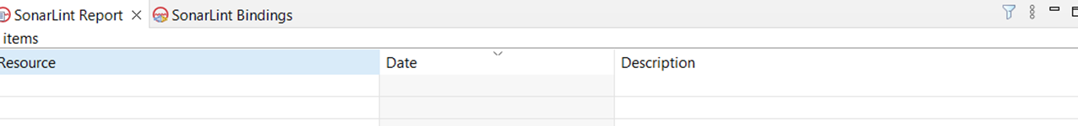
Rajeev Varshney

Slide 7
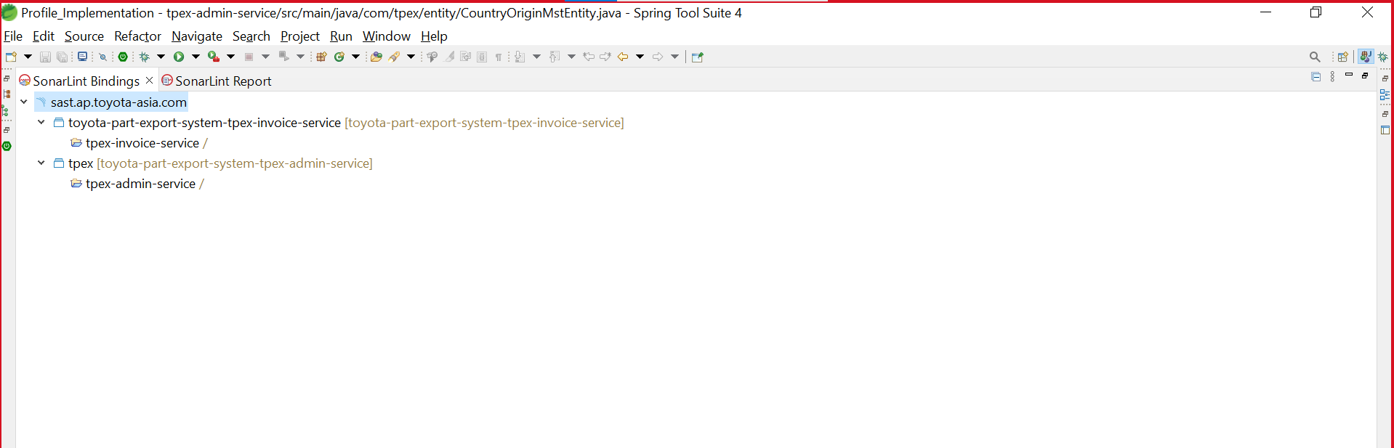
Dhananjay

Slide 8
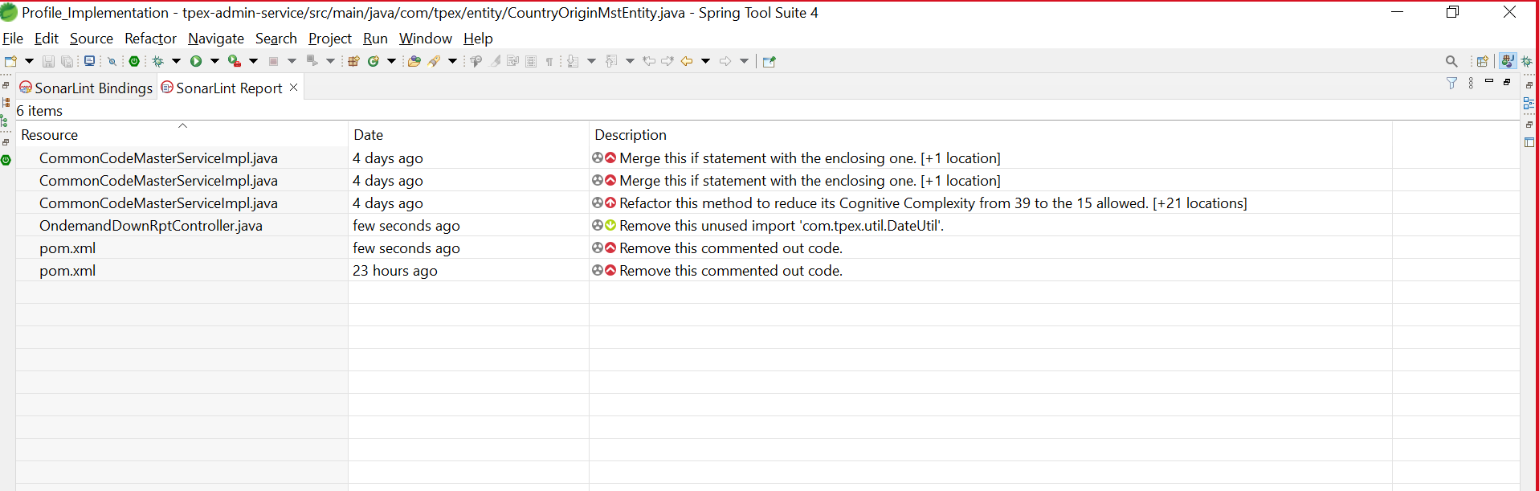
Dhananjay

Slide 9
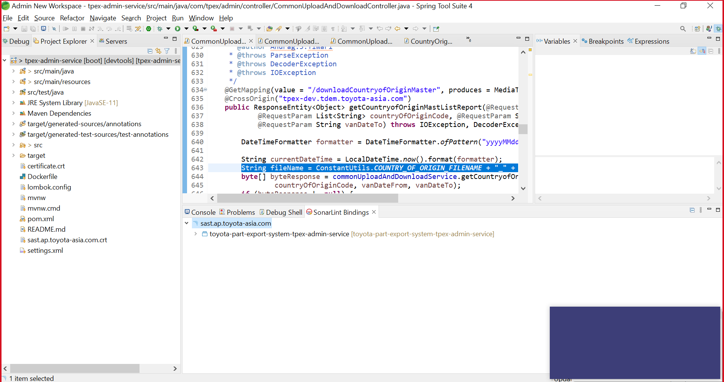
Anurag Tiwari

Slide 10
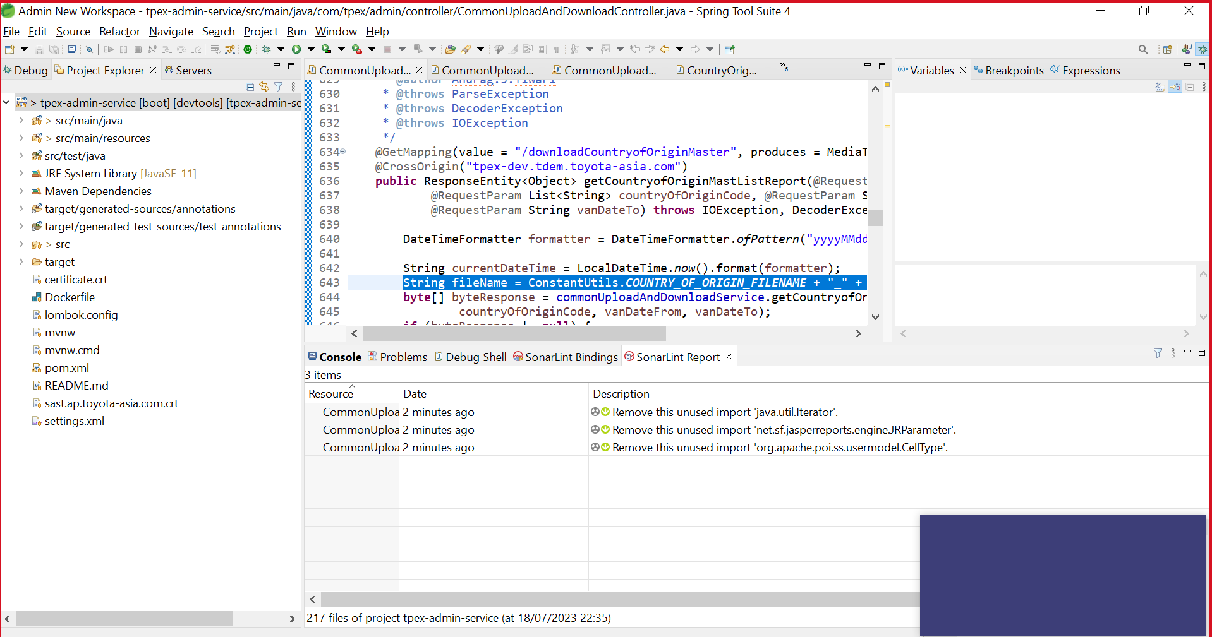
Anurag Tiwari

Slide 11
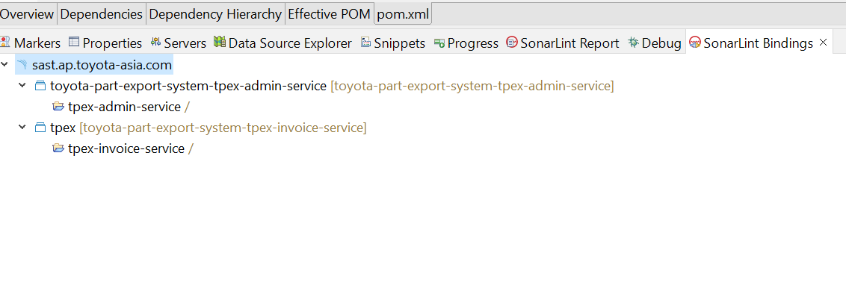
Piyush Puri

Slide 12
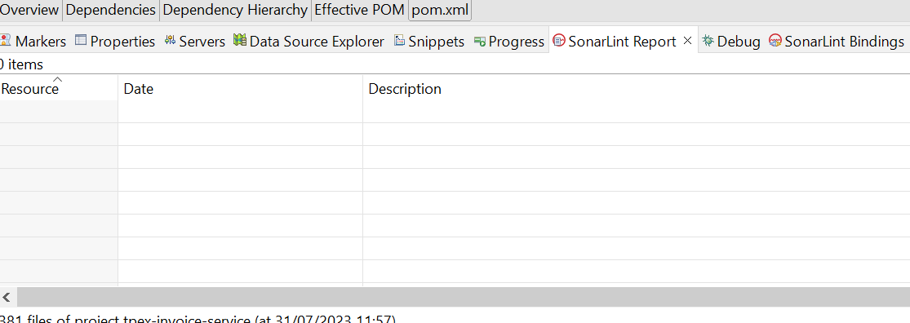
Piyush Puri - Report

Slide 13
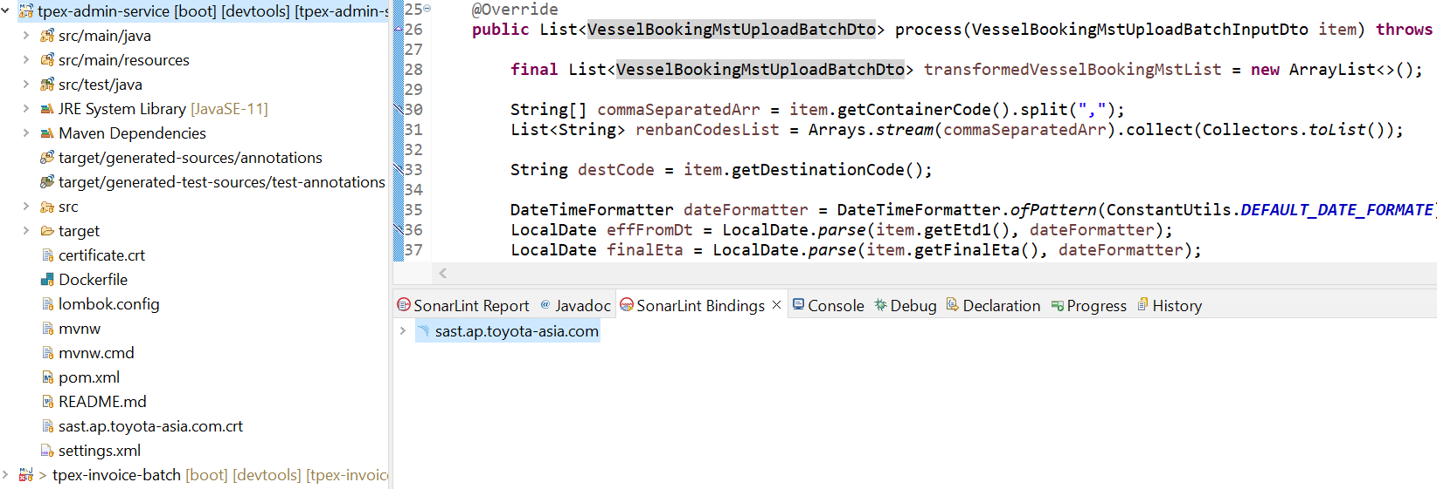
Mohd. Javed

Slide 14
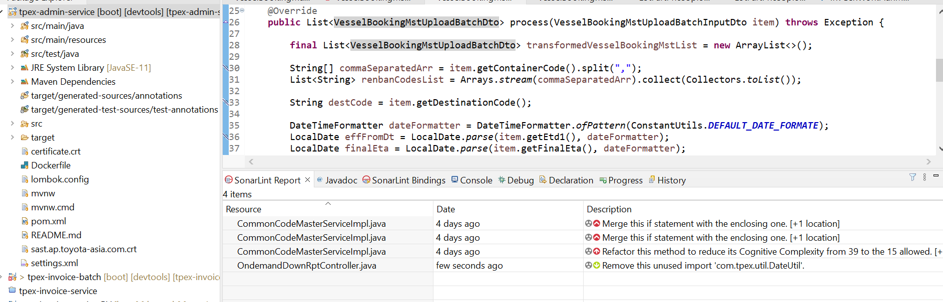
Mohd. Javed

Slide 15
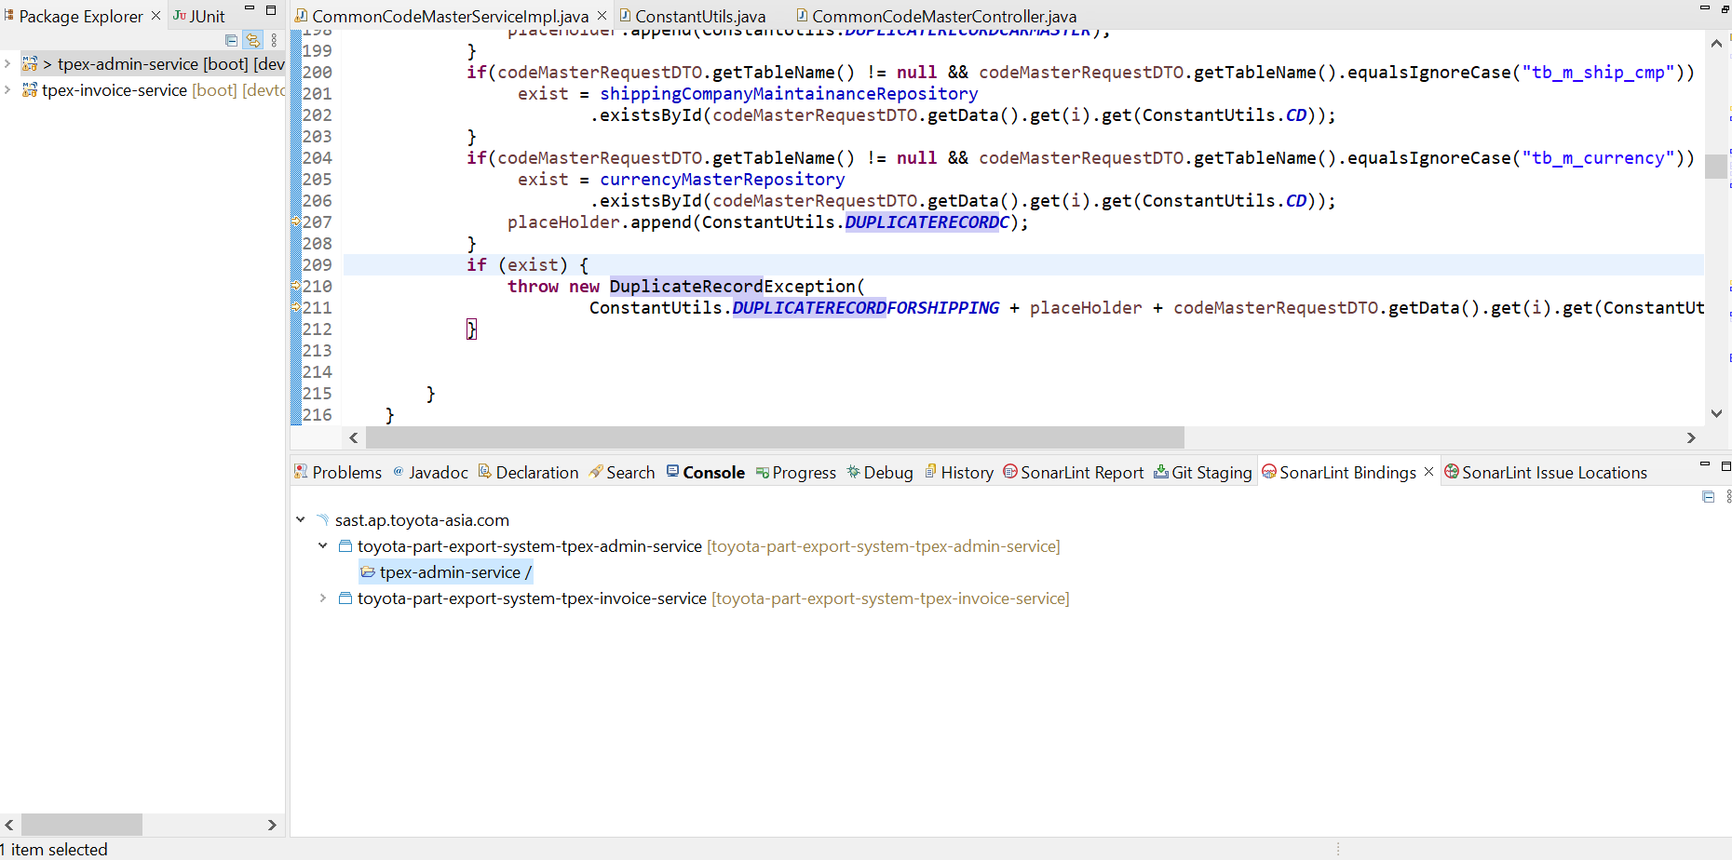
Usha Keshwal

Slide 16
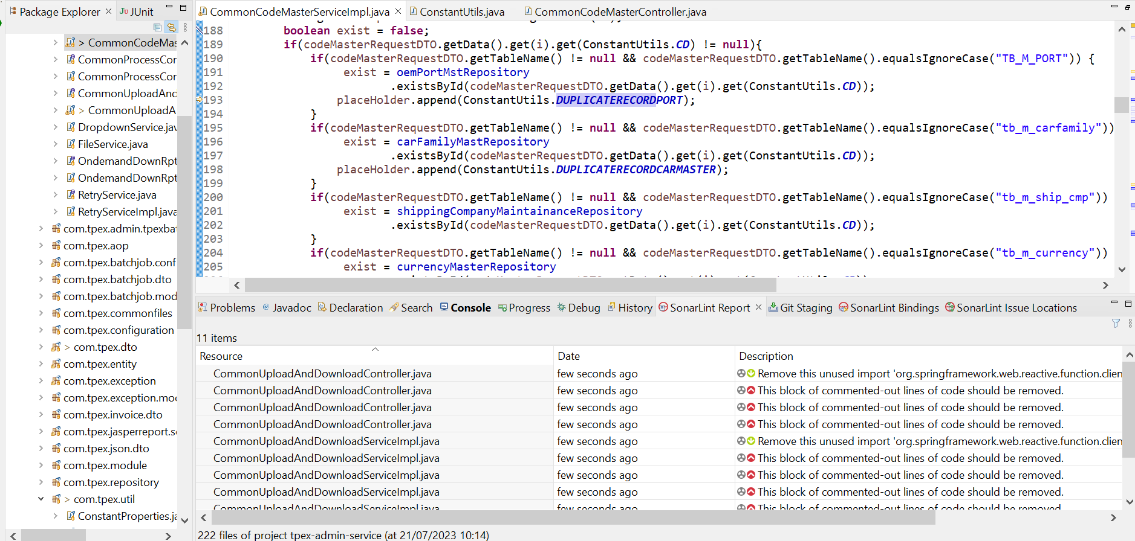
Usha Keshwal

Slide 17
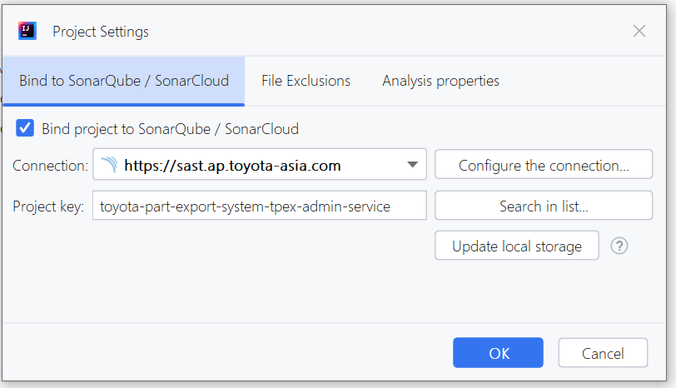
Manoj Kumar

Slide 18
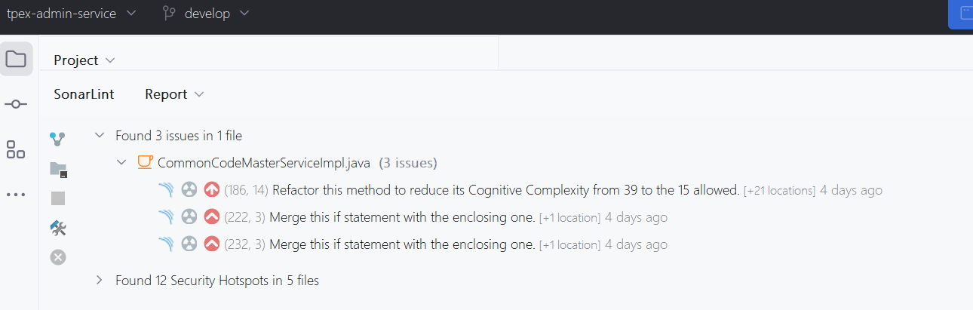
Manoj Kumar

Slide 19
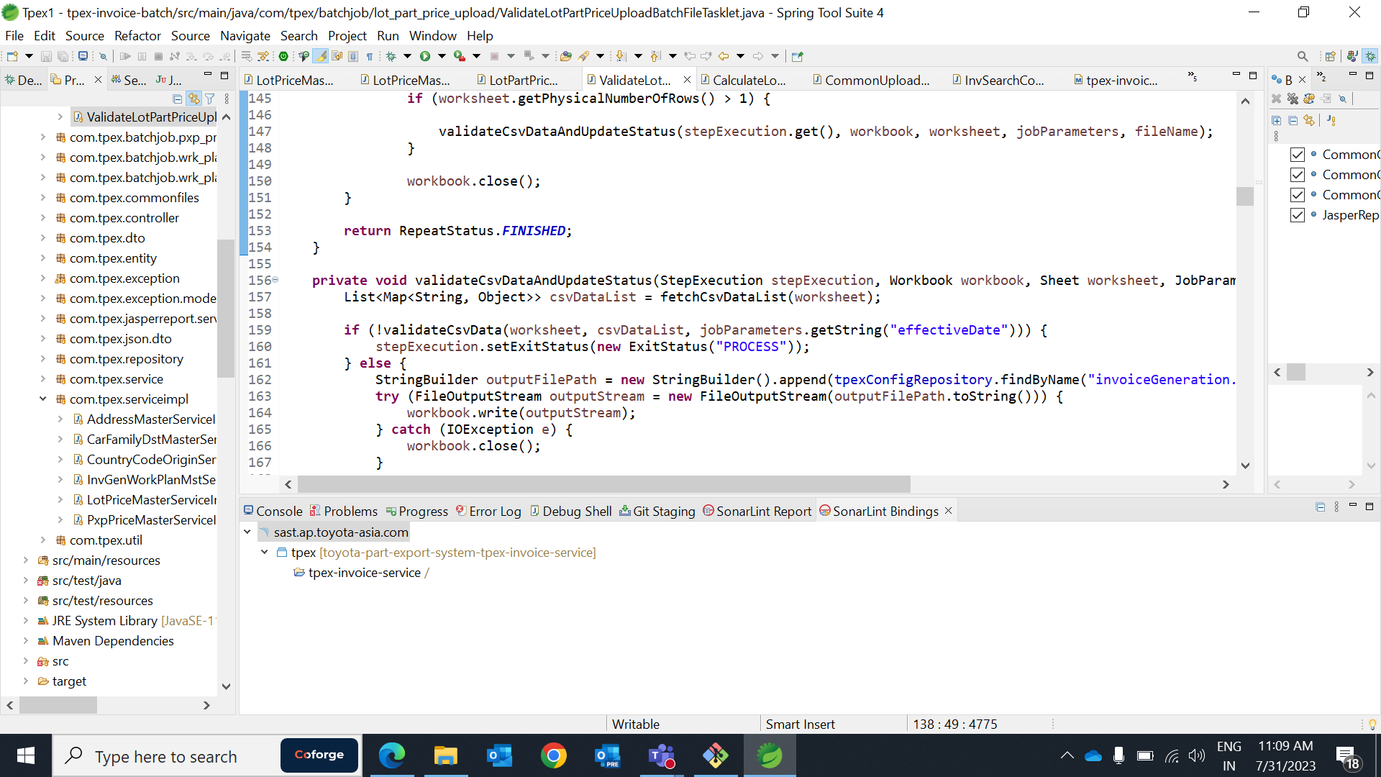
Deepak Kolhe

Slide 20
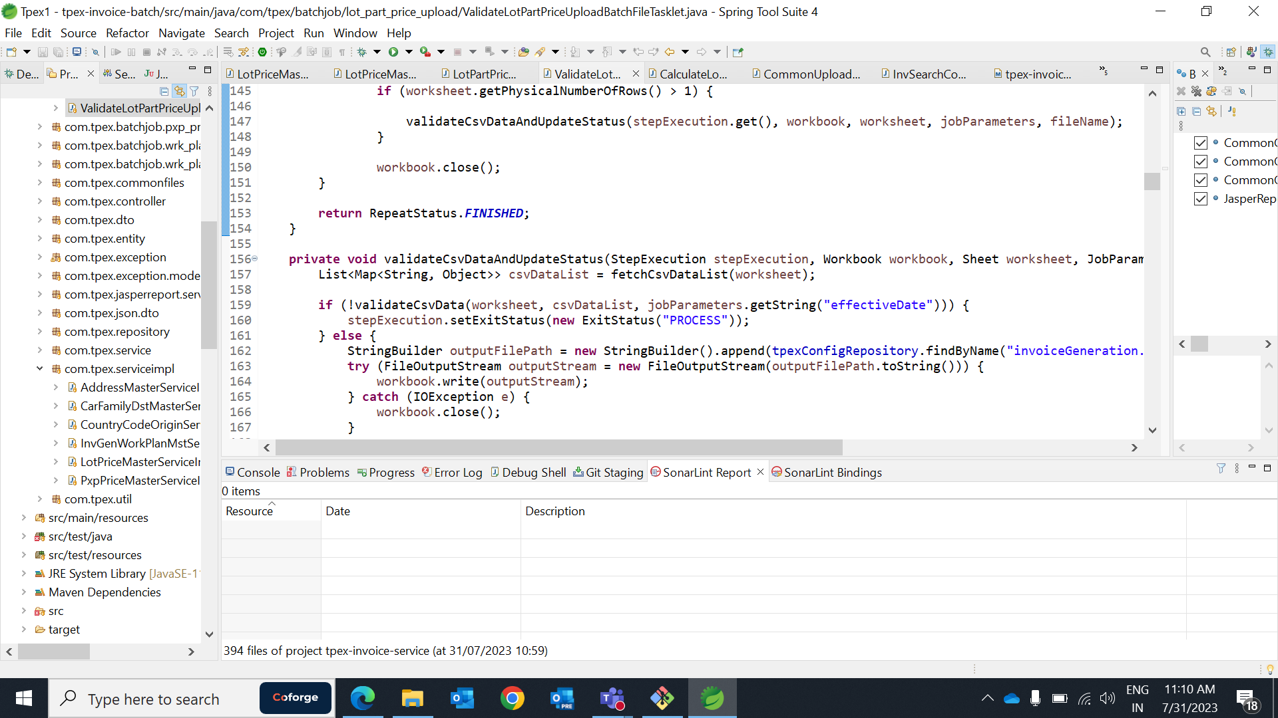
Deepak Kolhe

Slide 21
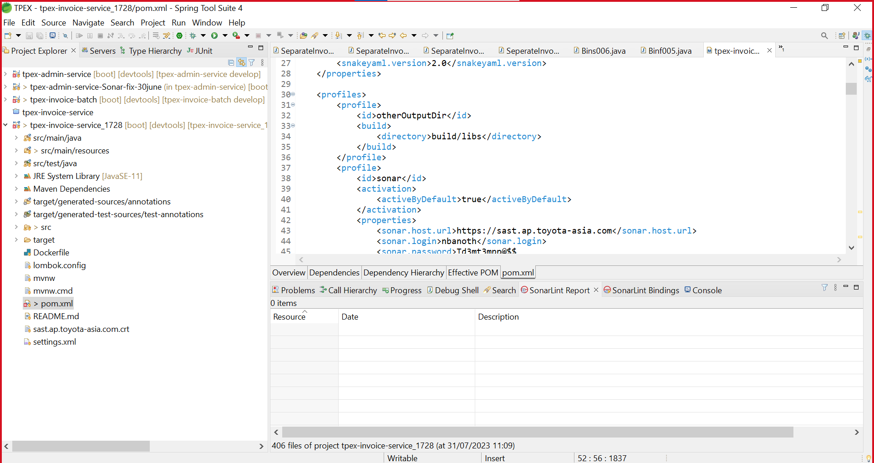
Naveen Banoth

Slide 22
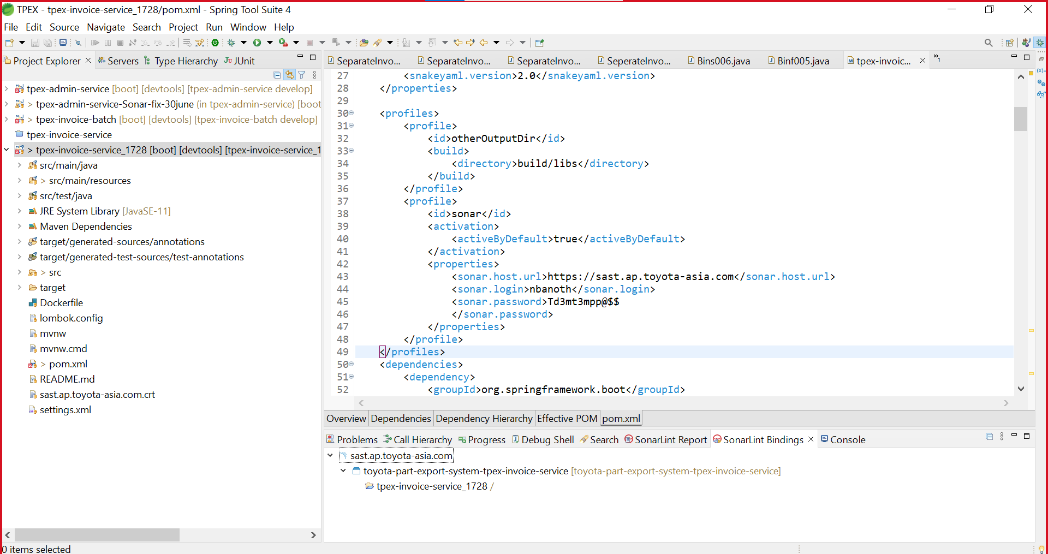
Naveen Banoth

